Slide 1
1
“ "Critical States of Soil and Geotechnical Centrifuge Tests”
Prague Geotechnical Days 2016
Andrew N. Schofield, Cambridge University Engineering Department
rchill College Cambridge
Notes:
Roscoe and Schofield (1963) “Mechanical behaviour of an idealised ‘wet-clay’ introduced 50 years ago a theoretical model of an aggregation of durable hard cohesion-less soil grains. 5 years later, in Schofield and Wroth (1968) ‘Critical State Soil Mechanics’ text book, this wet-clay was re-branded as Cam-clay. In an effectively stressed elastic-plastic aggregation of grains Taylor’s mechanical phenomenon called Interlocking can cause apparent cohesion without clay grain surface chemistry. Physical centrifuge model test may be used in validating computation.

Slide 2
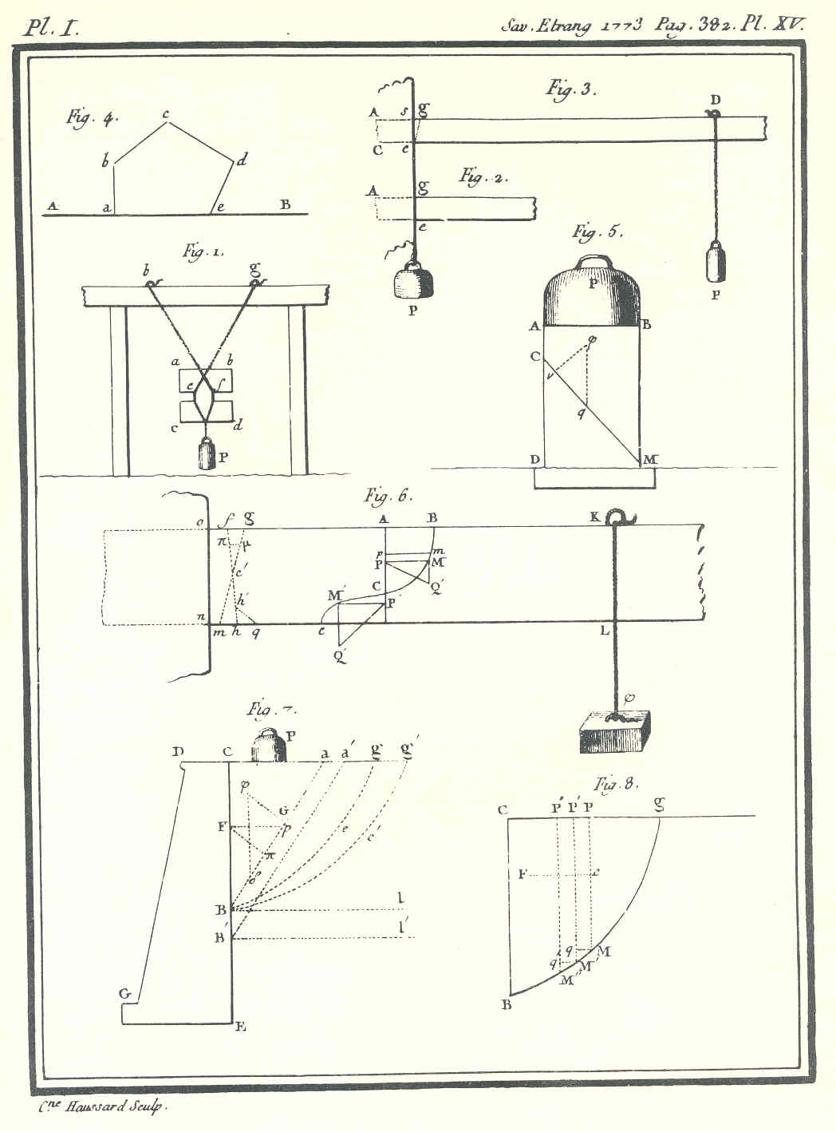
Coulomb’s (1773) design strength τ = c + σ′ tan φ_{d}
2
(2)
Coulomb shows two tests to find cohesion for rock and brick. Data in tension (1) were lower than shear (2), so a tension test gave a safe cohesion value to use in design.
He never tested soil; he took “nulle” cohesion φ = φ_{d}, c = 0 for disturbed, rammed earth (3).
(1)
(3)
Notes:
A notch (1) will concentrate stress in a brick and ensure that when it is pulled by a hanging weight it will fail in tension (2) a rope round a stub cantilever can shear it at the wall (3) Coulomb’s labourers would compact layers of earth as they built up his rampart
Note that the slip surfaces on which his strength equation applies are passing through heavily compacted soil

Slide 3
3
Terzaghi (1936) wrote that there is a “Fundamental fallacy…” as he measured lateral earth pressures different from the computed plane limiting stress fields, solving 3 equations in 3 unknowns (σ′_{x}, τ_{xy}, σ′_{y}). For soil with Tresca’s constant cohesion c′ the equations to be solved are 1 constitutive equation + 2 equilibrium equations (1/4)(σ′_{x} - σ′_{y})² + τ_{xy}² = c′².
(δσ′_{x} / δx ) + (δτ_{xy} / δy) = 0
(δτ_{xy} / δx ) + (δσ′_{y} / δy) = γ
The equilibrium equations are correct, hence Terzaghi’s “Fallacy” must have originated in a fallacious constitutive equation.
Neither the Mohr-Coulomb nor Tresca equations include a strain variable; but measured lateral earth pressures depend on strain.
When constitutive equations that attribute constant limiting-stress to every slip plane are replaced by alternative plastic-stability and plastic-work-dissipation equations we derive the Cam clay model.

Slide 4
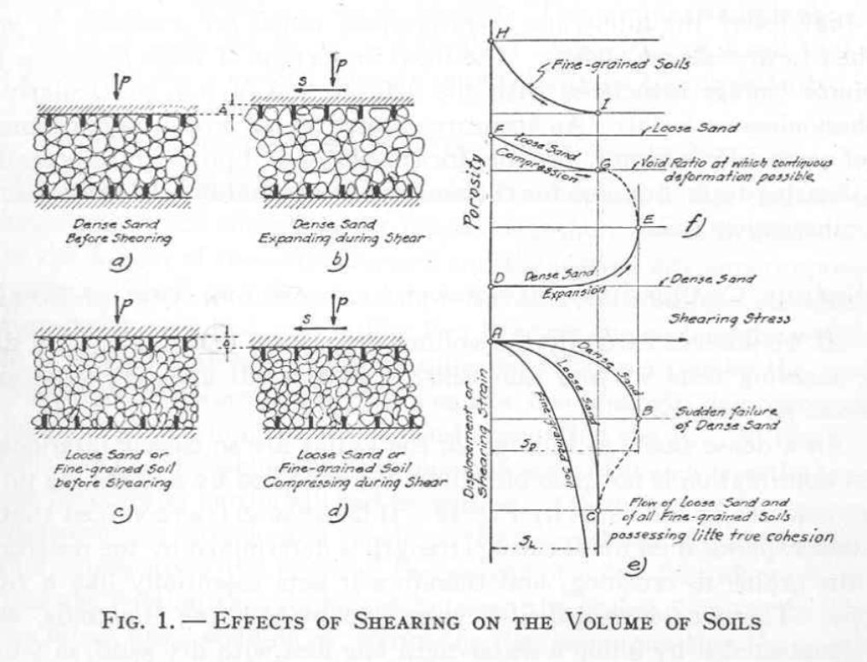
4
Casagrande (1936) proposed that at Void Ratios below Critical continuous shear deformation and liquefaction are impossible.
“dry” thirsty side
wet side
dry side
Critical Void Ratio
“wet” weepy side
Notes:
The word critical in “Critical State” came from Casagrande’s (1936) Boston Civil engineers “liquefaction” paper. When he considered tests in a shear box of dense and loose sand, he wrongly thought that any soil at a void ratio higher than critical will liquefy. The new Cam-clay model shows how soil on the wet side of critical will yield and harden with primary consolidation(not chemistry), not disappear in a liquefaction flow slide.

Slide 5
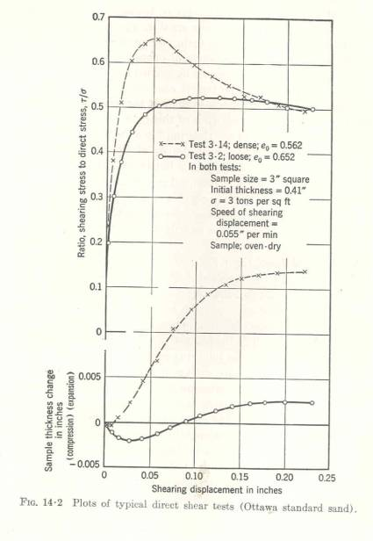
“Interlocking and Dissipation”; Taylor's (1948) data interpretation
5
y σ′ τ shear box
test of
sand
x
τ/σ′
x
max δy/δx = 0.16
y x
0.16
0.5
Taylor’s “interlocking” equation τδx = σ′δy + μ σ′ δx includes a Work-Dissipated component:- μ σ′ δx = (τδx - σ′δy). In steady slip a friction coefficient μ = 0.5 applies. The peak stress ratio τ/σ′ = 0.66 here is the sum of (steady friction) μ = 0.5, plus (interlocking) δy/δx = 0.16.
Notes:
Taylor (1948) interpreted shear box tests in MIT of Franklin Falls sand, assuming there is dissipation μ σ′ δx only in plastic distortion, and not in plastic volume change. Roscoe, Schofield and Wroth (1958) quoted Taylor’s assumption. We set our next research student (Thurairajah) the task of getting triaxial test data. Calculated work in each step in drained and un-drained triaxial tests gave the equation for the dissipation function (23).

Slide 6
6
Taylor’s MIT shear box tests (interlocking work)
P peak
P (positive)
interlocking
σ′(dy/dx)
friction
μ σ′
x
(b)
τ
strength =
friction +
interlocking
τ dry side
P C
B φ′ σ′(dy/dx)
interlocking
c′
μσ′ friction
φ_{d}
A σ′
(c)
Peak drained strength at P; see Schofield (2006) Géotechnique
y interlocking
maximum
(dy/dx)
x
(a)
Taylor’s interlocking strength equation
τdx = μσ′dx + σ′dy
Notes:
In fig (c) Terzaghi’s constant cohesion c’ is replaced by Taylor’s variable interlocking σ′(dy/dx) that decreases linearly from A to C as σ′ increases. It is positive from A to C. It then becomes negative. This differs from Coulomb’s equation. If Charles Coulomb were alive today he could be mortified to find that every engineer is taught to associate his illustrious name with an erroneous equation τ = μ σ′ + c’, and to think cohesion constant, unaffected by changing σ’. In Taylor’s shear box (dy/dx) data fitted τ = σ’ (tan φ_{d} + dy/dx). The equation τ = μ σ′ + σ′(dy/dx), with μ = tan φ_{d} fits data.

Slide 7
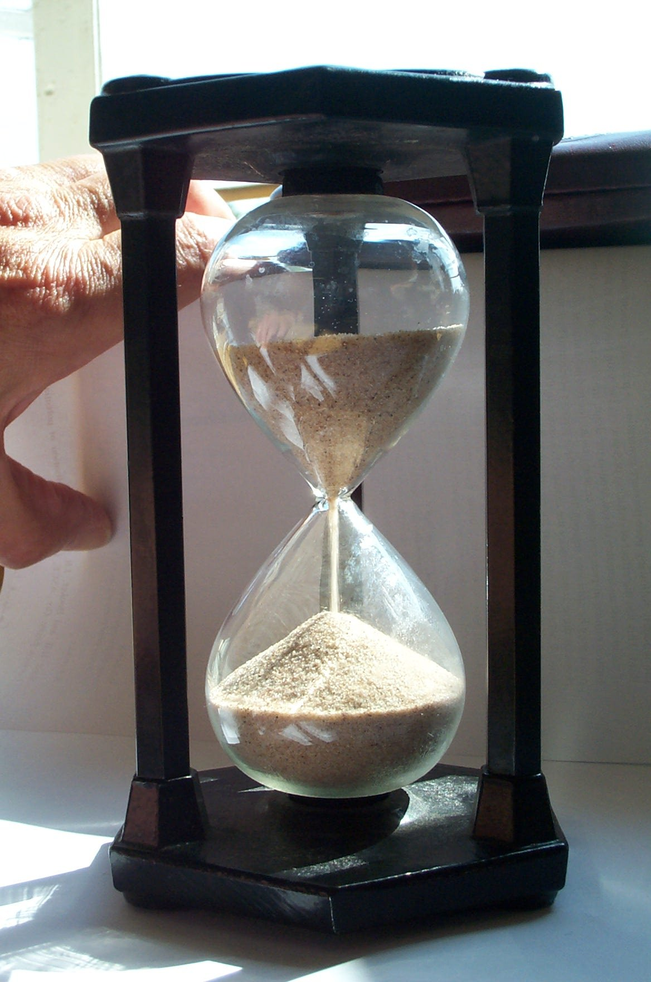
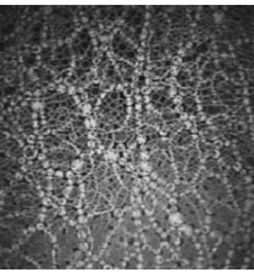
7
a) In a loose aggregate p′ is mean effective pressure; dε is shear distortion
c) In Allersma’s photo elastic image every bright grain stores energy. If p′ increases the grains get more bright. If dε increases more struts will buckle. A
function Μ p′ dε gives work dissipation
b) Hourglass sand at rest stands as a plastic solid

Slide 8
8
water bath
over-consolidated clay
soil stresses (σ′, τ) on slip plane
roller bearings
two load hangers
shear force, τ, displacement dx (2) normal force, σ′, dilation dy
Hvorslev’s drained shear box tests caused thin slip failure

Slide 9
9
Hvorslev used Terzaghi’s shear box to prepare and test clay with test paths from D to H to E (normal consolidation), from E to C to B (swelling) from B to F (slow increase of shear stress to peak-strength). He divided stresses by σ′_{e} in order to normalise pressures to line FAH as if all peaks were at w.
Δw D
ductile
w F A H
B
C
brittle E
ln σ′_{e} ln σ′
Terzaghi/Hvorslev;
the cohesion blunder

Slide 10
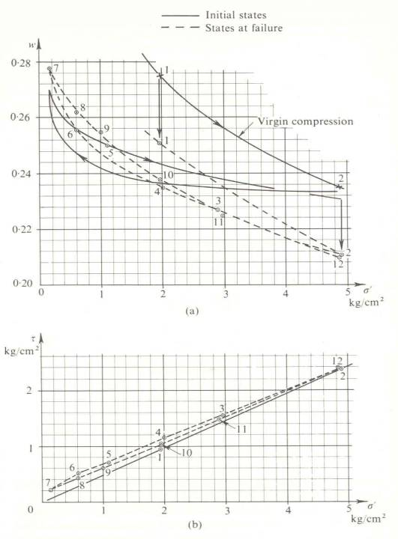
10
Shear box tests of clay
Hvorslev’s plotted data of clay compression and swelling, with solid lines before peak strength and dashed lines at slip, ➔
All peak shear strengths are quite close to and only just above a line with zero cohesion and fully softened friction φ_{d}
Data for σ′/σ′_{e} values in a range 0 < σ′/σ′_{e} < 0.6, but not for 0.6 < σ′/σ′_{e} ➔ Wet side of CS; no slip.
note water loss
wet side of CS
w
CS➔
σ′/σ′
τ
CS➔
0.6 < σ′/σ′_{e}

Slide 11
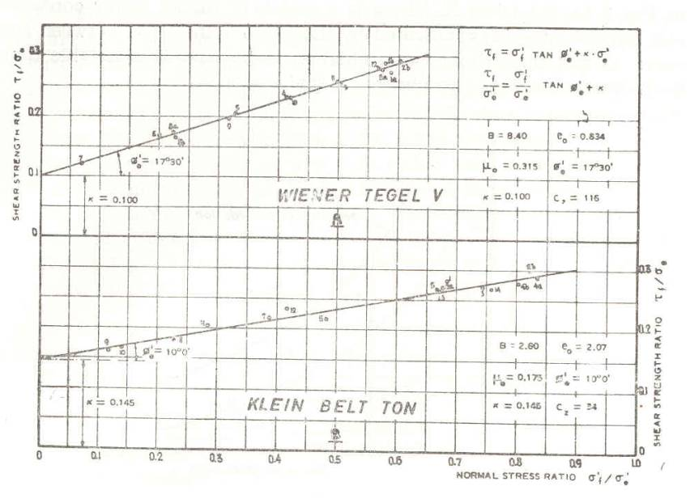
11
the CS
data
cluster
τ/σ′_{e}
σ′/σ′_{e}
Hvorslev’s peak strengths σ′ normalised by σ′_{e}

Slide 12
12
From principal stresses σ′₁, σ′₂ = σ′₃ we derive two state parameters; spherical stress
p′ = {(σ′₁ + 2σ′₂)/3} ,
and deviator stress
q = (σ′₁ - σ′₂).
A unit volume of solids in a grain- aggregate occupies v=(1+e). K is spherical effective stress p′ over volumetric strain; G is deviator stress over deviator strain.
Elastic media shear with v=const.; an increment in spherical stress δp′ causes volumetric strain decrement δv with no shear distortion because in elastic media +/-δq anti clock and clockwise shear stress increments cause +/-δε shear strain increments.
bulk modulus K
elastic increment
shear modulus G
Grain aggregates are plastic; +/- δε causes a dense aggregate to dilate and a loose aggregate to contract.
Notes:
I began Critical State Soil Mechanics research by considering elasticity, and then developed my (q, p’) triaxial state parameters and calculated work in plastic compression and distortion. Neither Mohr’s circles nor general tensor mechanics were helpful in calculating work. Roscoe & Schofield (1963) plastic continuum compression mechanics then fitted triaxial test data much better than Bishop & Henkel (1957 and 1963).

Slide 13
13
a) define deviator stress q =(σ_{a} - σ_{r}), and p′ = (σ_{a} + 2σ_{r})/3 – u,
with σ_{a} axial pressure, and σ_{a} = σ_{r} + (σ_{a} - σ_{r}) = σ_{r} + q.
σ_{a}
e (1 + e) = v
σ_{r} cell pressure
σ_{r}
σ_{r} 1
u pore water
pressure connection.
b) dl
l v v+dv
deviator strain increment
dε_{a} = (dl/l - dv/3v)
c) bulge slip
Soil States in Triaxial Test; plot data as state points (p′, q, v)
Notes:
Calculation of work in each step of a triaxial test path
σ_{r} dv/v + (σ_{a} - σ_{r}) (dl/l) = σ_{r} (dε_{l} + 2ε_{r}) + (σ_{a} - σ_{r}) dε_{a} = σ_{l}ε_{l} + 2σ_{r} ε_{r}

Slide 14
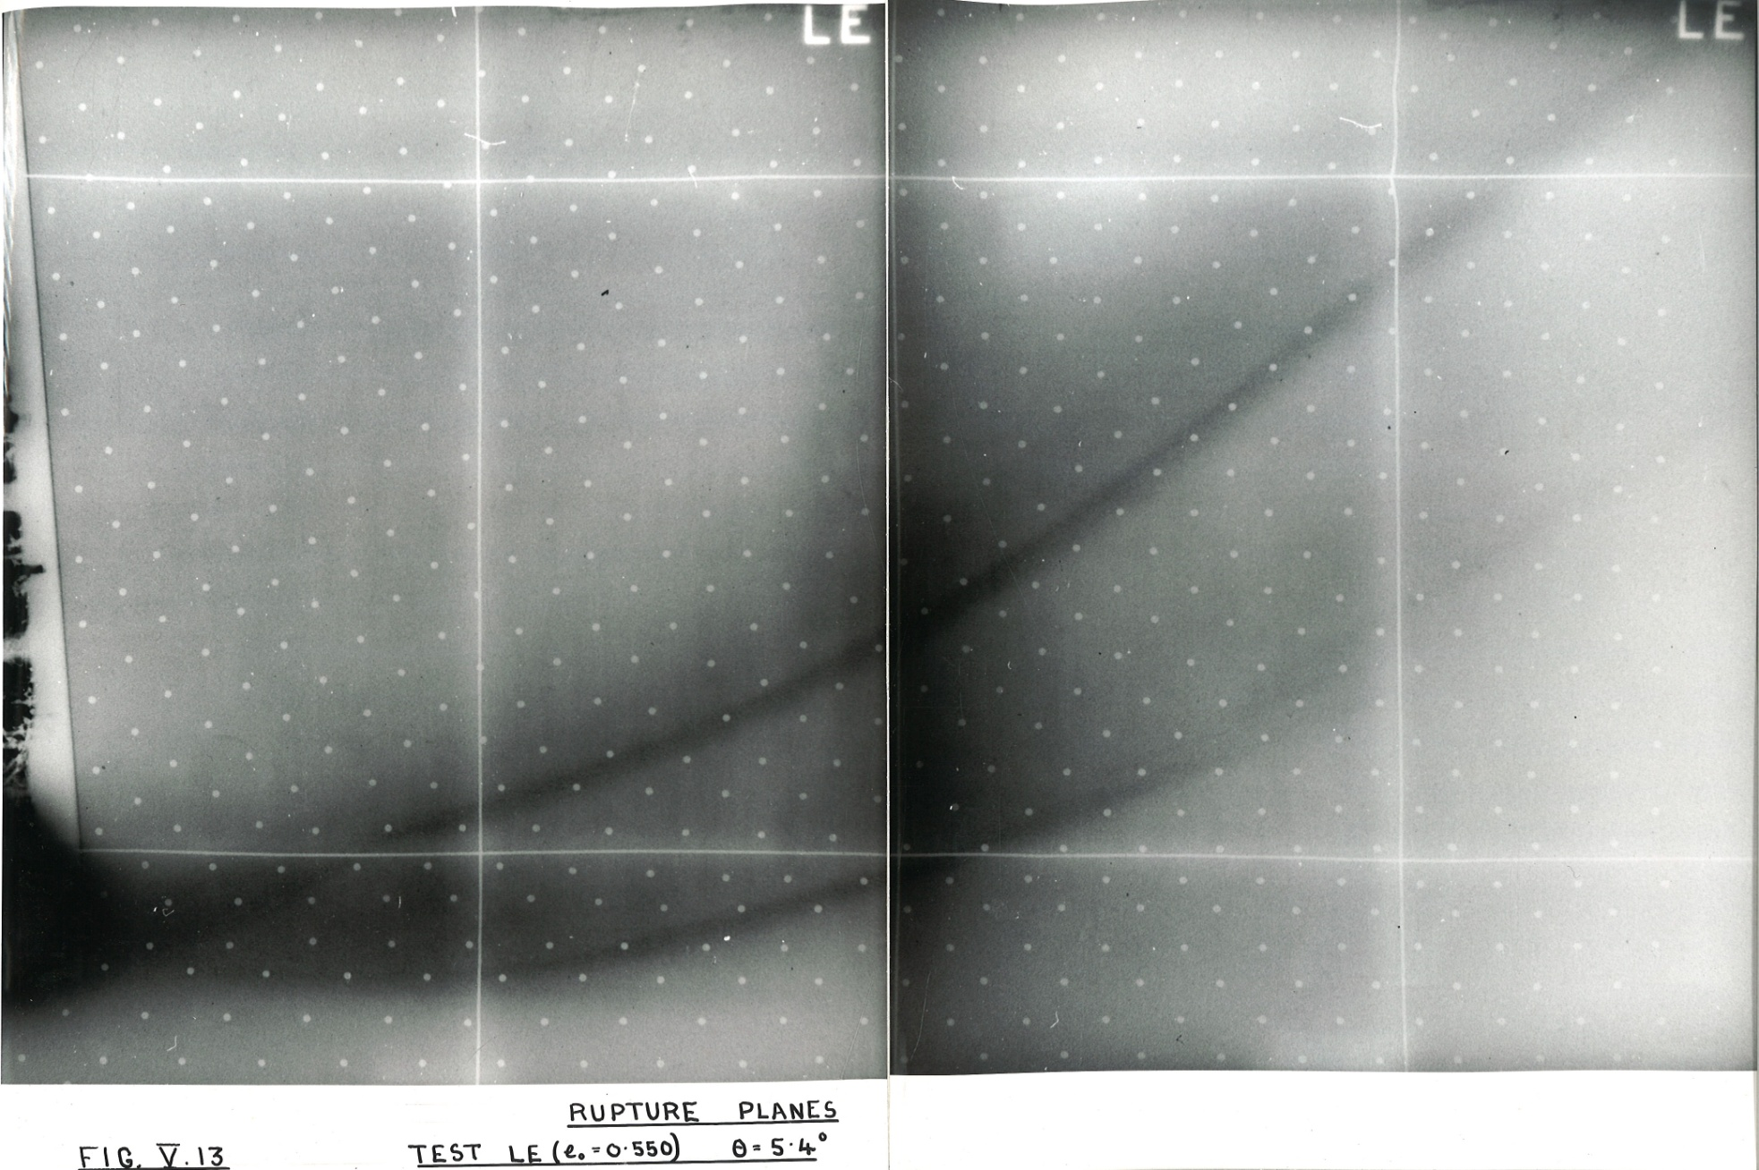
14
hinge
break out
X ray through a plane failure (James 1965)
A plate rotates about hinge at top left. Dense sand to right of the toe shears and dilates. A
Plate
densesand
toe
failure zone of loose sand (dark radiograph) develops in front of the toe. The lateral passive earth pressure force increases as the plate rotates. The toe moves up, initiating shearing and dilation in a new upper failure zone, that finally breaks out of the dense sand surface at the top right. By then the initial “failure zone” is inactive; what we see is “progressive failure”.
Notes:
When Terzaghi measured passive lateral earth pressure forces he did not consider rotation of principal stress direction. Schofield (1961) in Proc.5th ICSMFE (Paris.) observed that dilation of dense soil caused the magnitude of passive lateral pressure force in front of a rotating plate to increase as the principal stress direction rotated. A plane limiting frictional stress field computation predicted this phenomenon correctly. Micro mechanics of interlocking may produce this plastic continuum behaviour in an aggregate of sand grains, or of clay clusters. What we observe is widespread movement among grains, not slip on surfaces where limiting stress circles are tangential to a Mohr Coulomb envelope. Movement in an aggregate is very different from slip in a machine like a petrol engine. Our grains tumble and jump about.

Slide 15
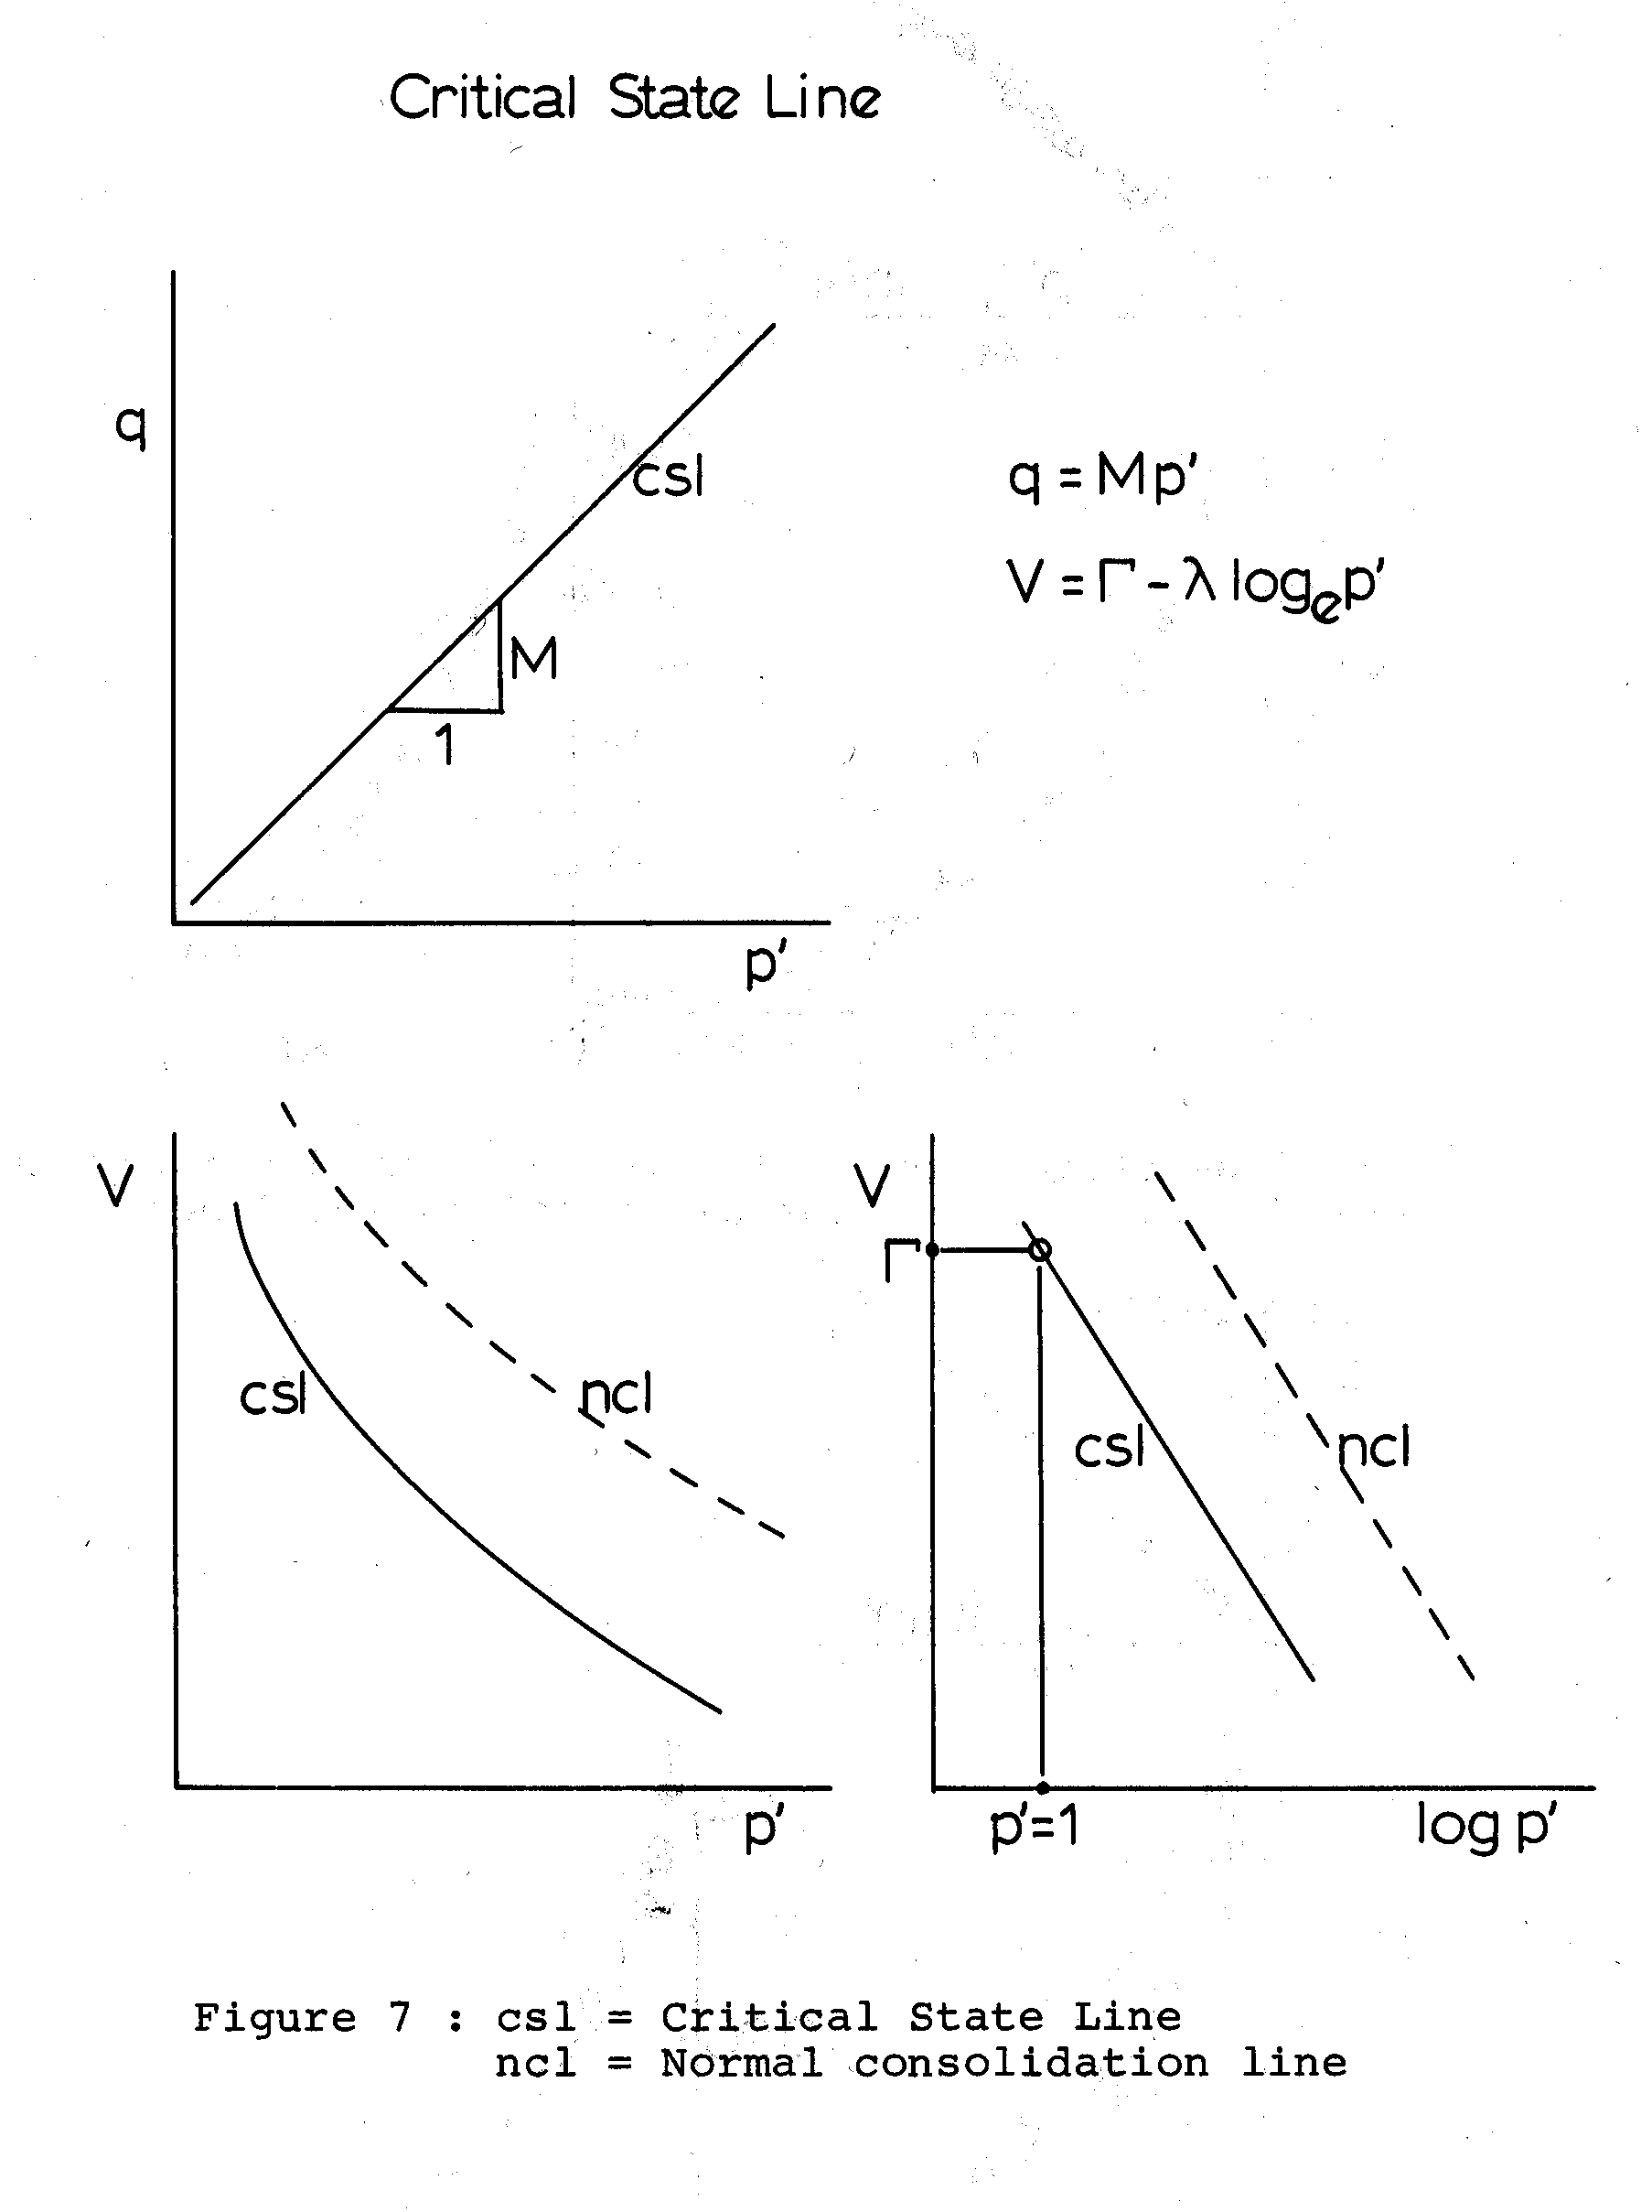
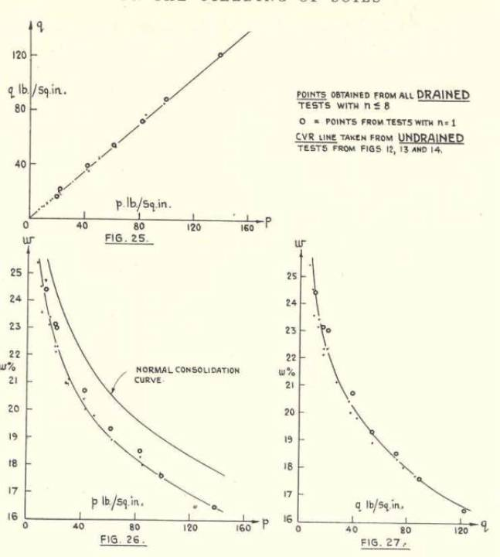
15
Roscoe, Schofield, & Wroth’s (1958) (p′, q, v) test-data paths approach a Critical States line
Notes:
At Caltech 1963-4 I realised that the Plasticity Index in Casagrande’s soil classification is simply the slope of a Critical State line. A liquid limit test finds what change of water content will increase un-drained strength 100 times (with falling cup) or 3 times (with falling cone). The existence of CS lines suggests a new conjecture for Earth Science about evolution of granular aggregates as they flow during the processes that lead to formation of the topology of the Earth.

Slide 16
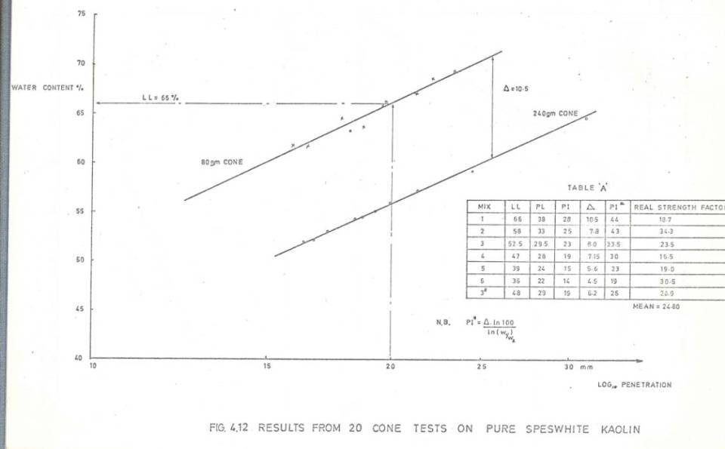
Plasticity Index based on 80gm and 240gm fall cone tests
16
80gm
Δ w
240gm
Plasticity index is change of water content that increases CS strength 100x
Water content % change Δ w will increase CS shear strength 3x
Notes:
If a CS paste X is three times stronger than a CS paste Y, then a 240 grm fall cone will penetrate the same depth into paste X as an 80 grm cone penetrates into paste Y. The US Army used Casagrande’s test (equivalent to the fall cone) successfully in construction all round the world in WWII, so CS theory should have world wide applications in construction .

Slide 17
Ductility and continuity in soil mechanics
17
A paste of soil saturated with water is plastic, (from the Greek word πλασσειν plassein to mould, as in moulding pottery from clay).
An aggregate of separate hard grains in a crıtıcal state will behave as a ductile plastic continuous material.
Plastic design leads us to select construction materials and methods; soil, if over compacted to high peak strength, is not plastic and ductile

Slide 18
Strains by the associated plastic flow rule
18
In plastic flow, as a body yields under combined stresses σ_{i} σ_{j} with strain increments δε_{i}^{p} δε_{j}^{p}, the flow vector is normal to the yield locus at (σ_{i} σ_{j}).
δε_{i}^{p} δε_{j}^{p}
σ_{i}
δσ_{i} δσ_{j}
(σ_{i} σ_{j})
σ_{j}
For stability the product
of any stress increment vector (δσ_{i} δσ_{j}) and the plastic strain rate flow vector may not be negative; δσ_{i} δε_{i}^{p} + δσ_{j} δε_{j}^{p} > 0.

Slide 19
Construction without plastic ductility
19
Ductility can save life. The 1995 Oklahoma Federal Centre bomb damage showed how a lack of continuity and ductility will cause a risk of brittle failure.

Slide 20
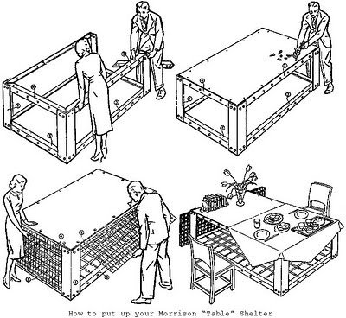
20
“Morrison” WW2 mild steel bomb shelter had PLASTIC DESIGN by
Prof John Baker on the basis of the work dissipated in rotations of “plastic hinges” at failure.
Notes:
Cambridge Professor Sir John Baker plastically designed the Morrison Shelter for UK Civil Defense. V2 rockets in WWII made houses collapse. The work dissipated in bending mild steel dissipated the work of a house moving down 6 inches. A housewife and children sleeping in the 30inch high Morrison shelter, had 24inches to stay alive in (a friend of mine did so). An authentic geotechnical plastic design requires an “soil aggregate mechanics” that includes plastic compression and optimum compaction.

Slide 21
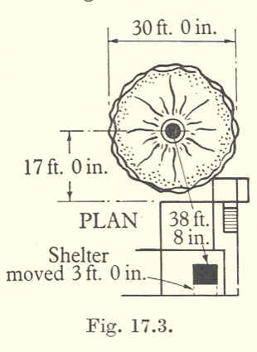
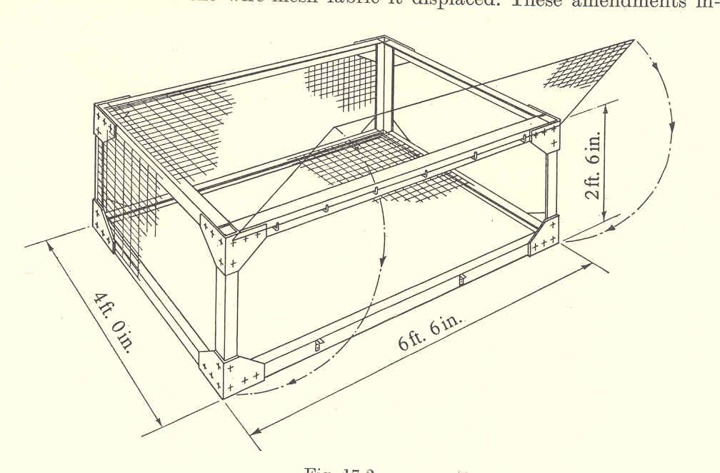
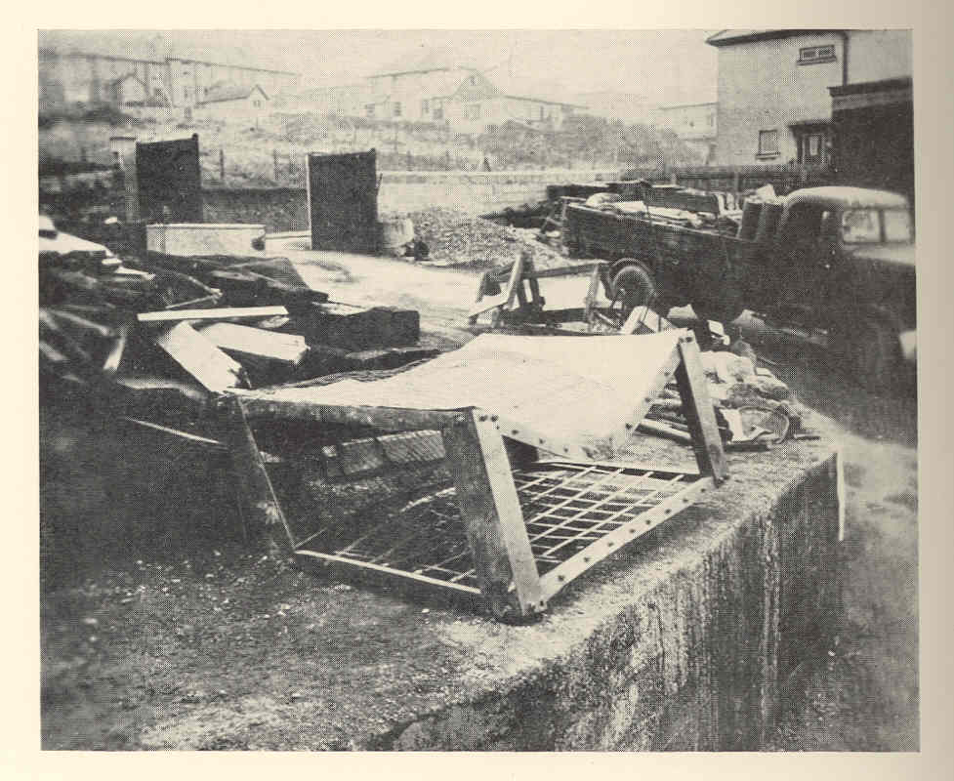
Plastic design of steel frame structures, Baker (1948)
21
A WW II 250kg bomb burst near a Falmouth house. As it collapsed the 20 lb/sq.ft upper-floor load fell 9 ft on the bomb shelter, A mother and 3 children survived, asleep in the shelter.
Space inside any structure is made more safe by designing full plastic strength at floor to wall connections (contrast photo with structural failures of Oklahoma Federal Center and New York Twin Towers).
Notes:
Plastic design in WWII produced a bomb shelter that saved many lives. A hard learned lesson of WWII was too quickly lost immediately after WWII when Western Engineering educators forgot and failed to teach this war-time mantra; always design fully connected structures with plastic ductility.

Slide 22
Derivation of original Cam-clay (1963) q/Μp′=1-ln(p′/p′_{c})
22
q cs (dv,dε ) v
q = Μp′
q = η p′
dp′ dv + dq dε = 0 associated flow cs line
p′ dv + q dε = Μ p′ dε dissipation function η line
Divide both sides by p′ dε and then eliminate dv/dε
dv/dε = - (dq/dp′) = Μ - (q/p′).
With η=q/p′ then dη/dp′=1/p′(dq/dp′-q/p′) = -Μ/p′. ln(p′)
Hence ln p′ dη= -Μdp′/p′. When integrated this gives η/Μ=1-ln(p′/p′_{c}).

Slide 23
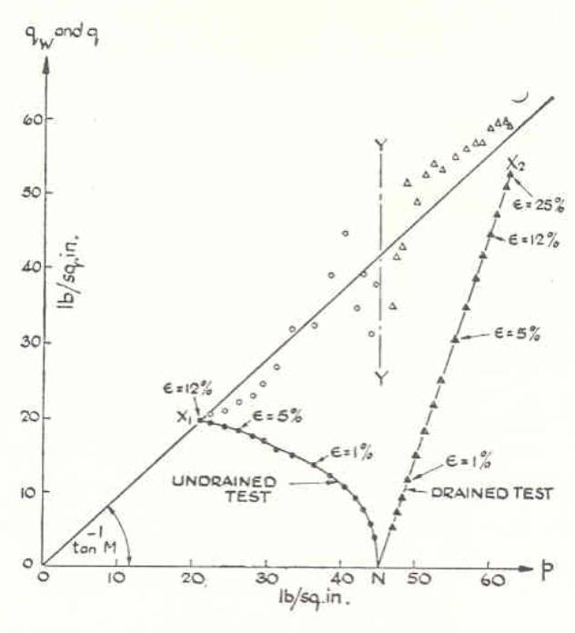
Thurairajah’s (1961) analysis
23

Slide 24
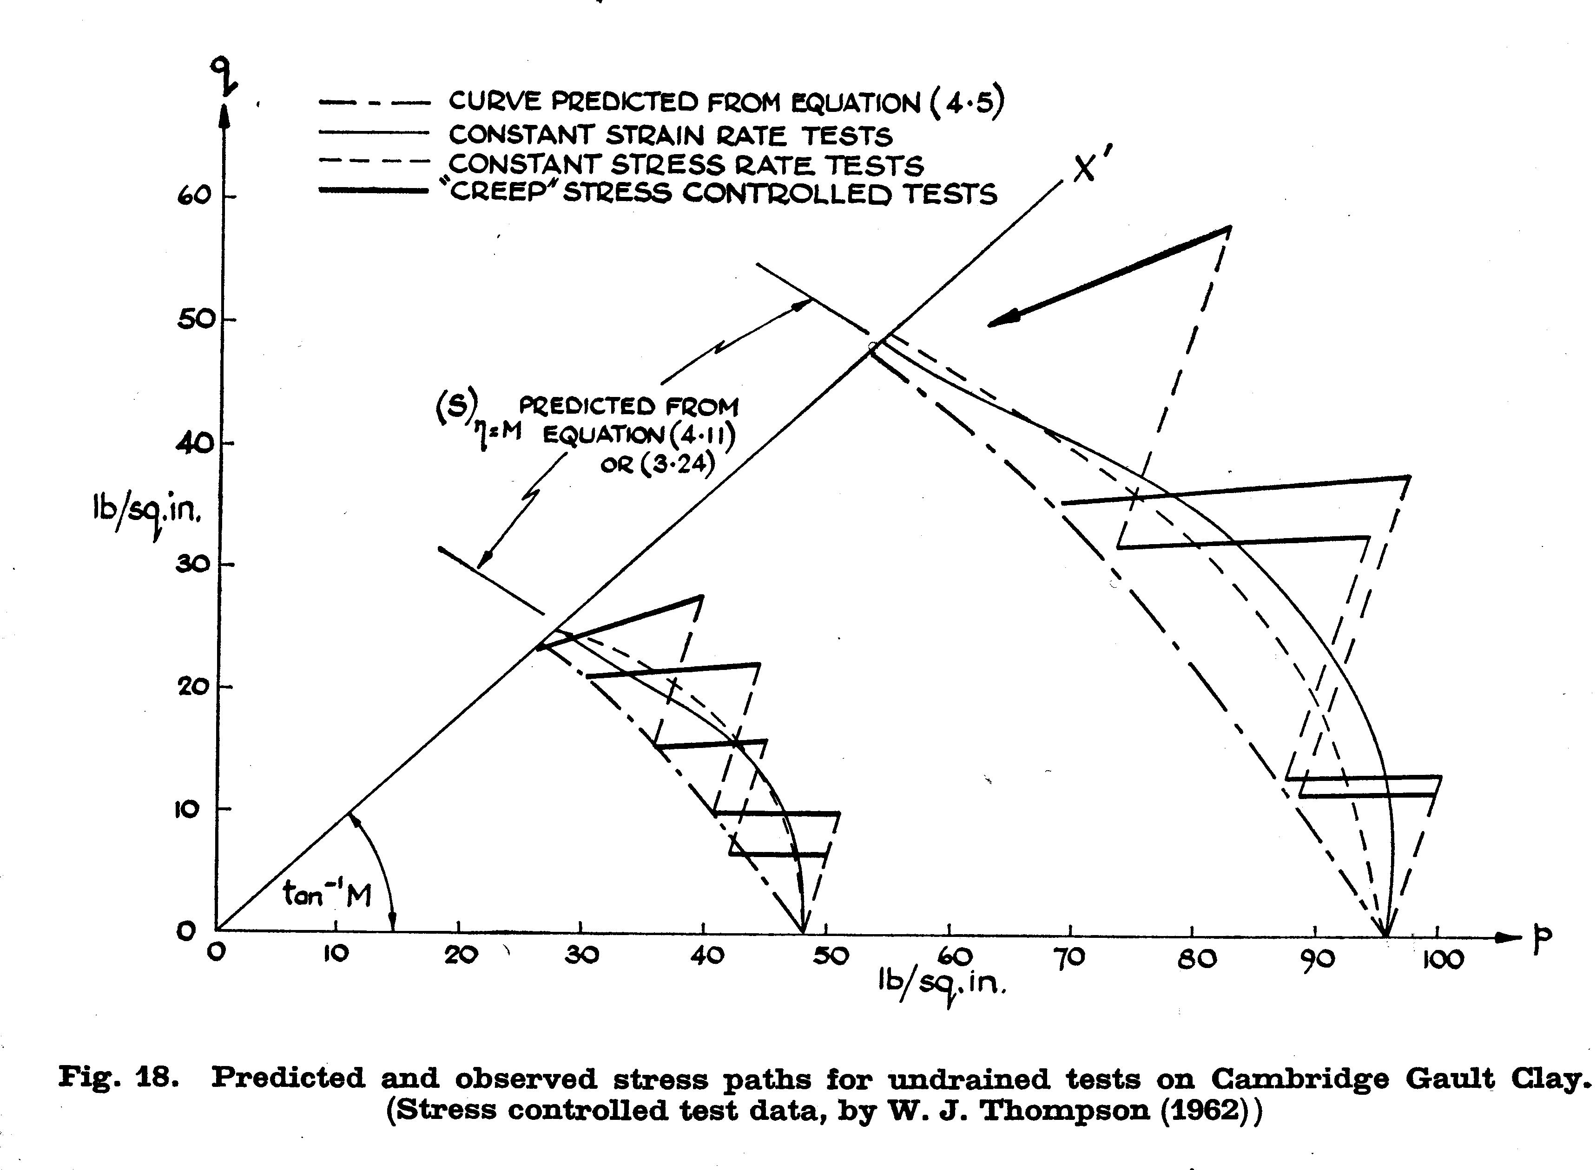
24
Cam clay curve is
creep strength
Thompson (1962) creep data

Slide 25
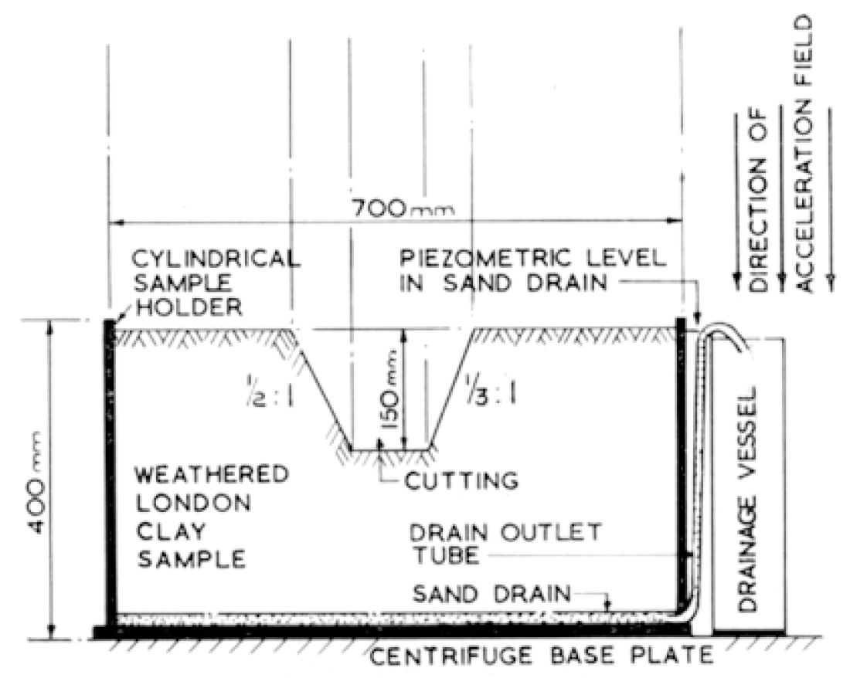
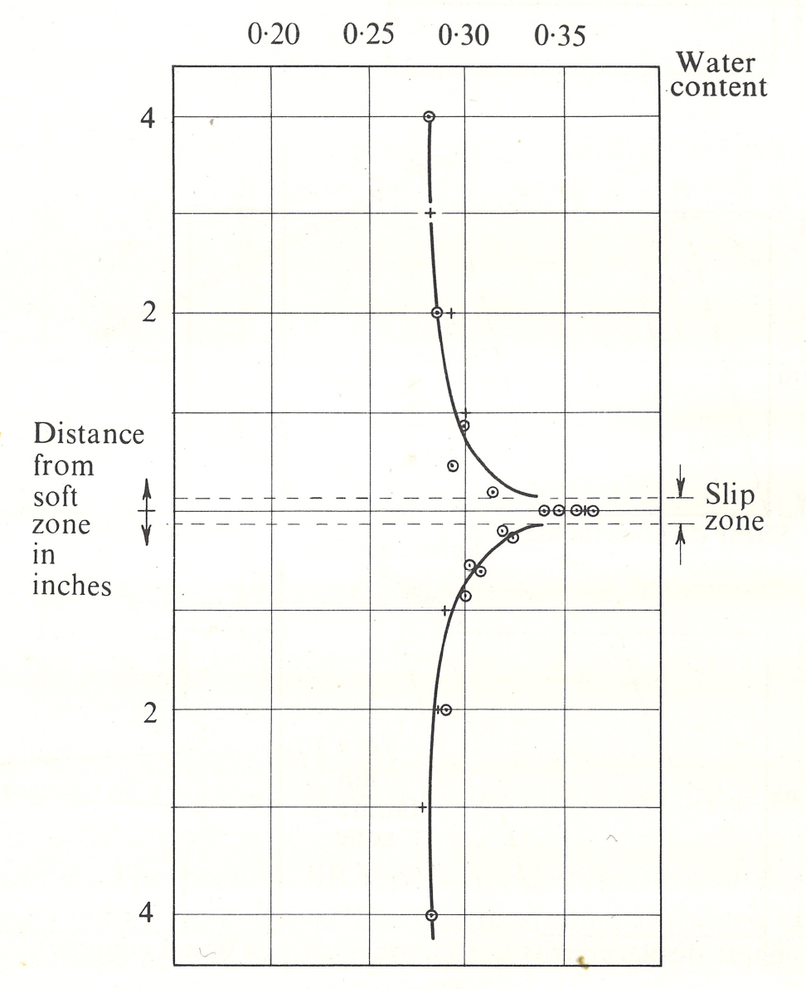
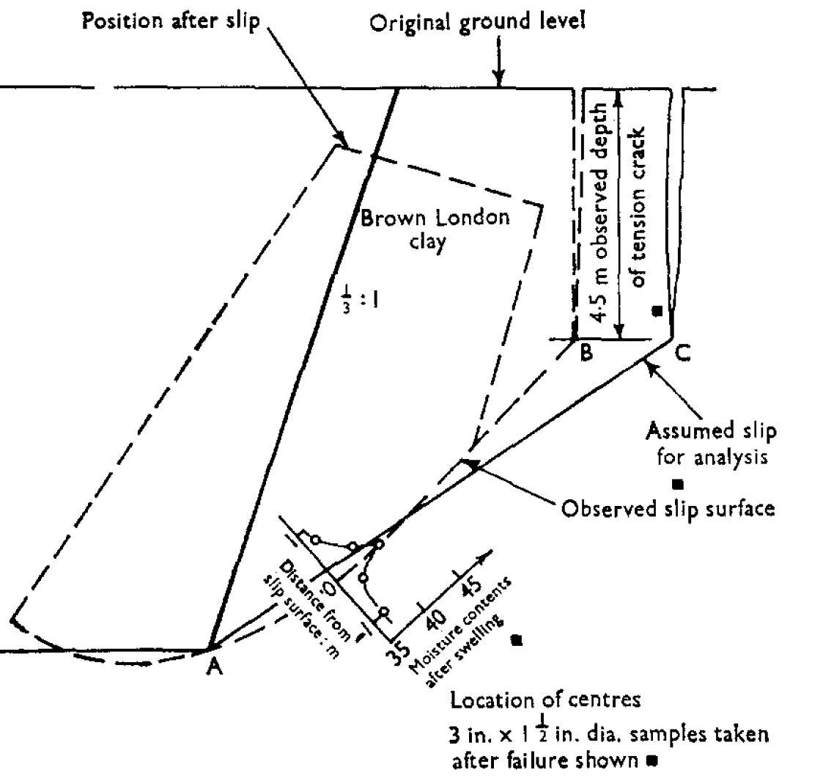
London clay “cut-face stand-up” model test
25
Henkel (1956) shows moist slip-surfaces in stiff fissured ‘lubricated-block” London clay rubble behind an old retaining wall.
Skempton suggested that clay strength is
time dependent. An alternative is for stand-up to involve diffusive swelling to Critical-state failure as in this model of Bradwell cut stand-up time (i.e. Lyndon & Schofield 1972, not Skempton & La Rochelle1965)
Notes:
Skempton made Arup a bad prediction of a long stand-up time, based on his theory of time-dependent cohesion. Our centrifuge model test predicts the stand-up time of the cut face of London clay at Bradwell nuclear power station. Lyndon and Schofield (1972) argued that swelling and softening of London Clay is a problem of pore water diffusion for which a centrifuge scale-squared model may provide a correct prediction. Centrifuge model testing has used field samples. We have made large models from undisturbed block sample with blocks cut from a bench or taken by heavy construction plant such as a back hoe in the field in the way that Lyndon did at UMIST.

Slide 26
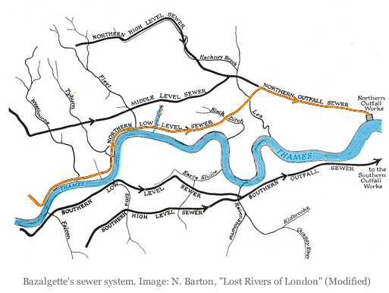
Notes:
The invert grade of Bazelgette’s sewers intercepted streams that were befouled with sewage, ensuring self cleansing channel of sewerage to Thames outfalls below London. Similar trench invert grades in the new 20th century sewer pipes caused flow at same speed.

Slide 27
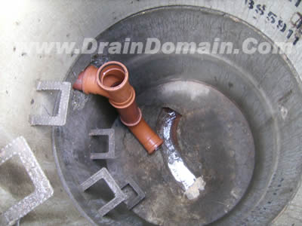
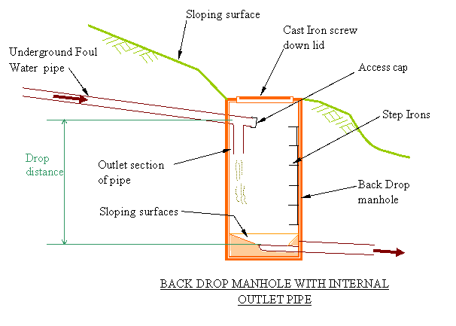
A backdrop will reduce sewer flow rate, but will cause deep trench-heading damage
Notes:
Deep trench headings at backdrops prevented channel flow in sewers becoming too fast but our British Gas research suggested that caused ground movement that pulled pipe joints apart, and gas escape caused house explosions. The 20th century UK public could get the safe benefit both of new sewers and new natural gas, if soil movement at new trench headings could be limited. Rooke read Kusakabe’s research thesis and then negotiated with the Water Boards a safe distance of their trench headings from his British Gas pipes to eliminate the risk of damage, gas escape and explosions.

Slide 28
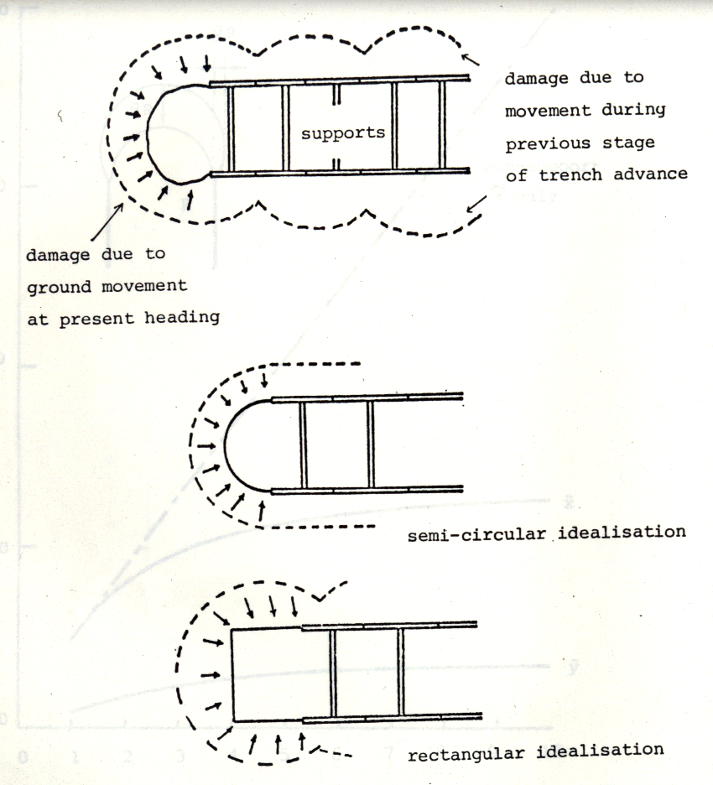
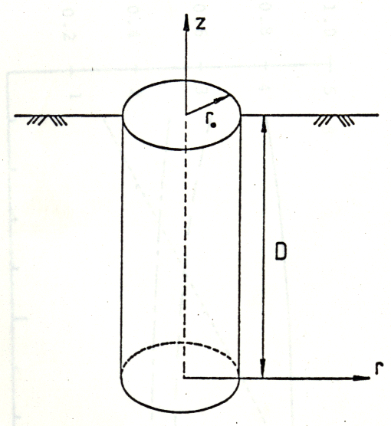
Kusakabe’s model tests for British Gas
Notes:
Struts can support the sides along a trench but the heading face is unsupported while it is being cut. In our model a cylindrical shaft in the centre of a cylinder of soft saturated clay was filled with heavy mud. When drained in flight at 100G the unsupported sides of the hole failed, revealing a mechanism of failure from that that is well known along a length of trench side.

Slide 29
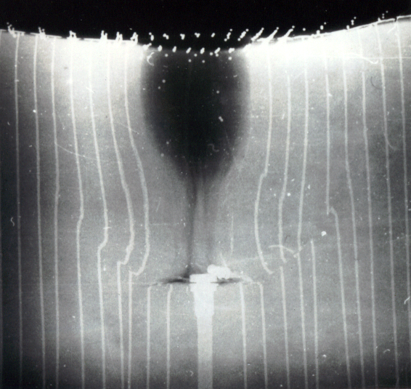
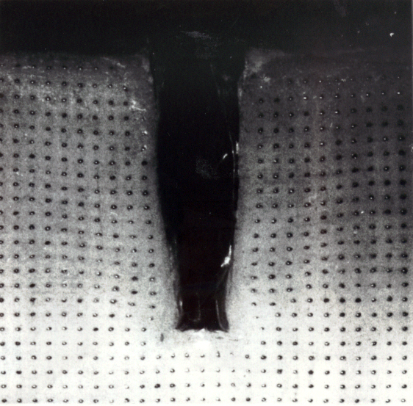
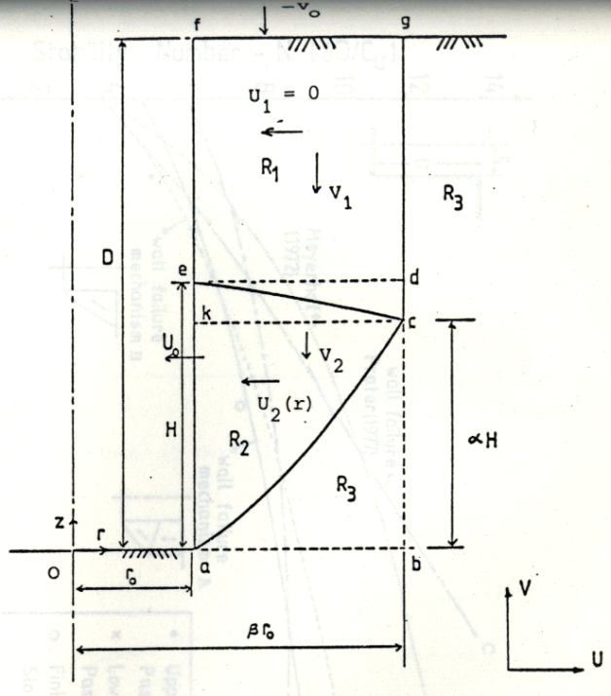
1980 centrifuge-model test by PhD research student Osamu Kusakabe (now Professor, Tokyo Institute of Technology) showed axisymmetric circular shaft failure mechanism.
Notes:
Kusakabe injected lines of lead powder in oil into the clay before the test and an X-ray image showed where the slip surface had cut them. In another plane strain test the container had a transparent wall on the centre-line showing movements and damage ahead of the trench.

Slide 30
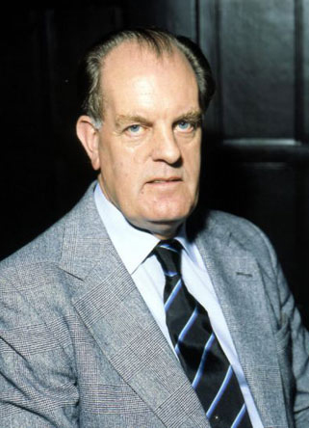
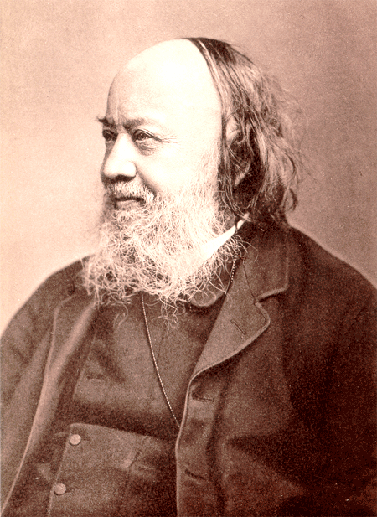
Sir Denis Rooke 1924-2008
Sir Edwin Chadwick
1800-1890
Notes:
Piped flow of water in 19th century Chadwick introduced main drainage, water, sanitary and municipal engineering into the UK. The 20th century Rook distributed North Sea gas in UK. In 1975 10 Regional Water Boards were created with new funds and dug new sewer trenches that pulled buried British Gas pipes apart and caused house explosions; Rooke was determined to stop movement of gas pipes.

